Slide 1
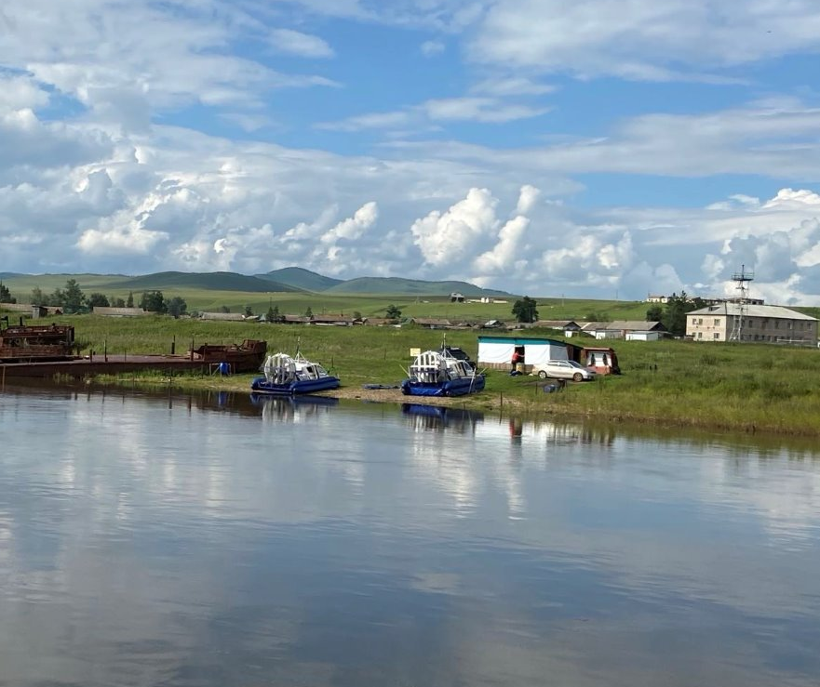
Global River Water Quality under Climate Change and Hydroclimatic Extremes
by van Vliet et al., 2023
Zhe Liu, Jingyi Hou, Wen-Lin Tsai​

Slide 2
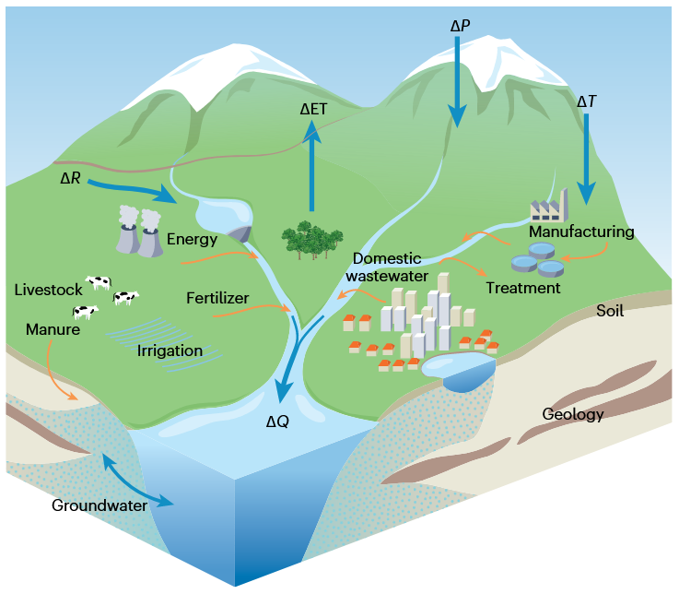
River Water Quality and Its Influencing Factors
(precipitation)
What is Water Quality?
Overall, it refers to a measure of water composition in terms of its suitability for a particular function or use.
Influencing Factors (Drivers)?
Hydroclimatic: Precipitation, evaporation, runoff.
Geographic: Land use, geology, soil characteristics.
Human Activities: Water extraction, (un)treated wastewater, fertilizer usage.
These drivers can be interrelated.
(evapotranspiration)
(temperature)
(surface runoff)
(discharge)

Slide 3
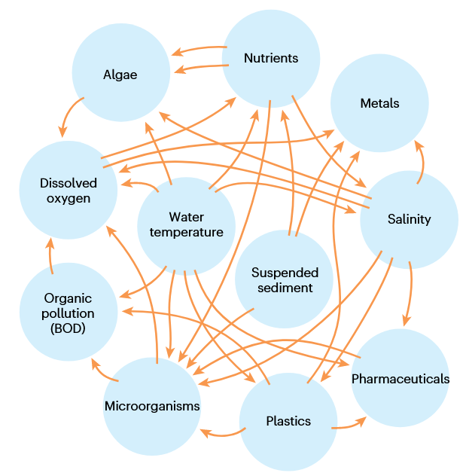
Complex Interactions Influencing Water Quality
Interactions between different water quality constituents
Interactions Across Different Water Types
Interactions Between Water Bodies: rivers, lakes, reservoirs, soil, and groundwater.
Temporal Effects: These interactions create legacy impacts over time.
Spatial Effects: Impacts propagate spatially within river basins, such as from upstream to downstream.
Water quality is a multi-dimensional challenge shaped by intricate interactions across water systems and constituents, requiring comprehensive monitoring and management.
3

Slide 4
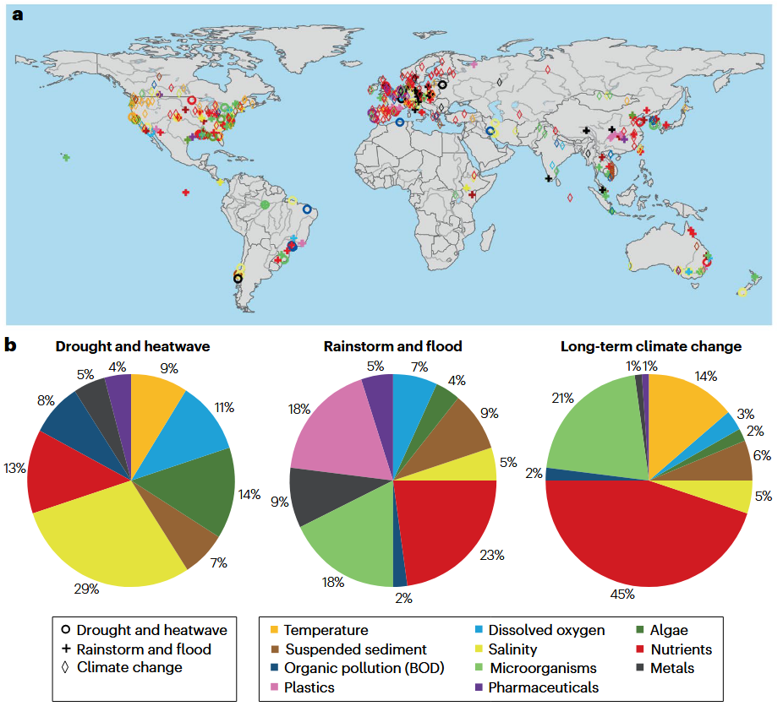
Climate Change and Extreme Weather: Impacts on River Water Quality
Research Gap:
Compared to water quantity, water quality impacts from climate change and weather extremes remain underexplored.
Limited systematic assessments at regional-to-global scales.
Scope of Review:
965 case studies (2000–2022) analyzing water quality impacts from short-term (daily–monthly) extremes to long-term climate change
Focused on 11 major water quality constituents
Long-term Climate Impacts (70%, n=680)
Extreme Weather Events (30%, n=285)
Rainstorms & floods (18%)
Droughts & heatwaves (11%)

Slide 5
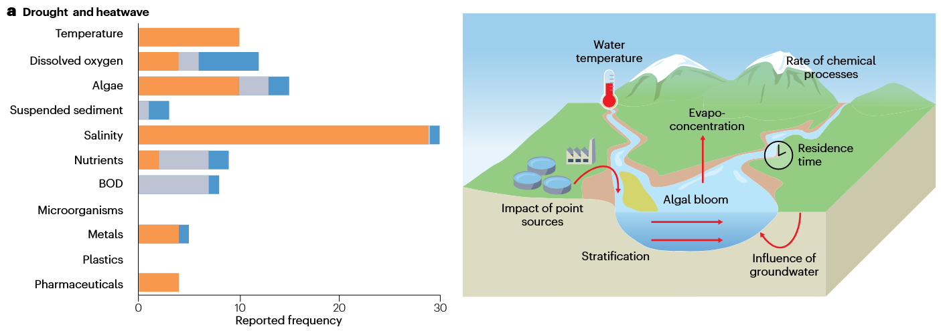
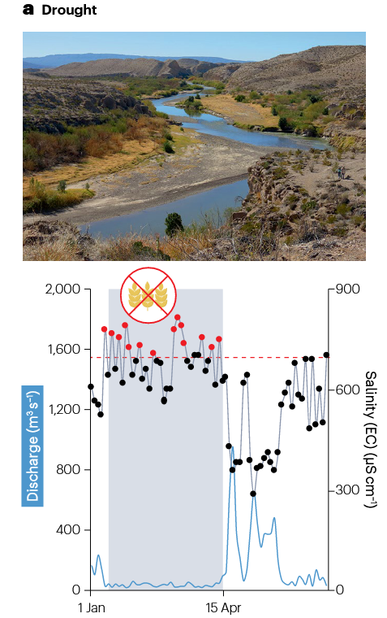
Impacts of Droughts and Heatwaves on Water Quality
Cause water quality deterioration (68% of cases)
Southern US rivers
Drought
Main Drivers of these changes:
Reduced dilution capacity and self-purification capacity
Increased salinity
Lower Suspended Sediments (positive effect)

Slide 6
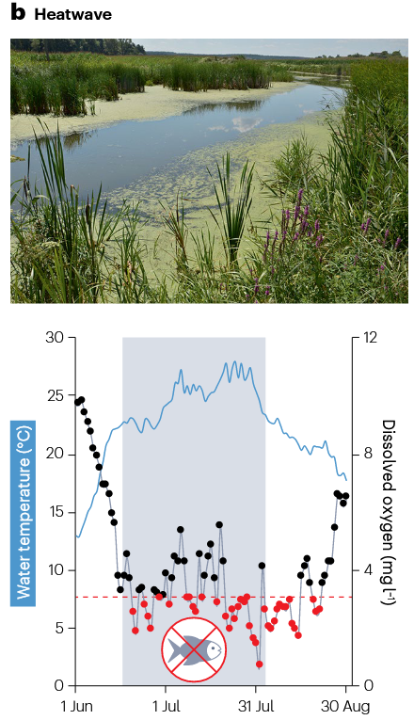
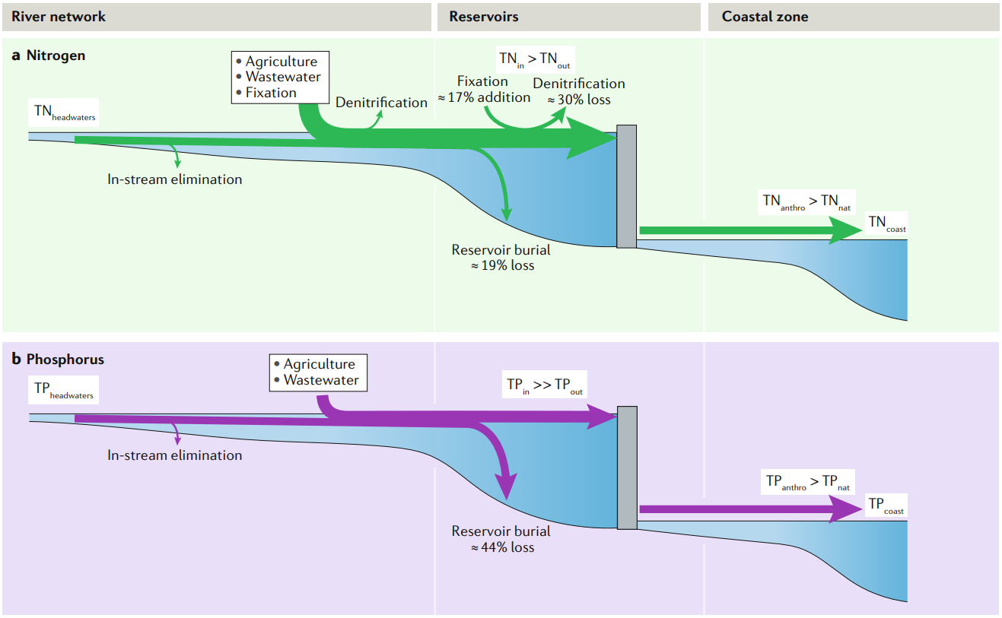

Impacts of Droughts and Heatwaves on Water Quality
Dam
The construction of dams, reservoirs, and other engineering structures further alters hydrodynamic conditions and nutrient cycling, exacerbating water quality and ecological issues.
Meuse River in Europe

Slide 7

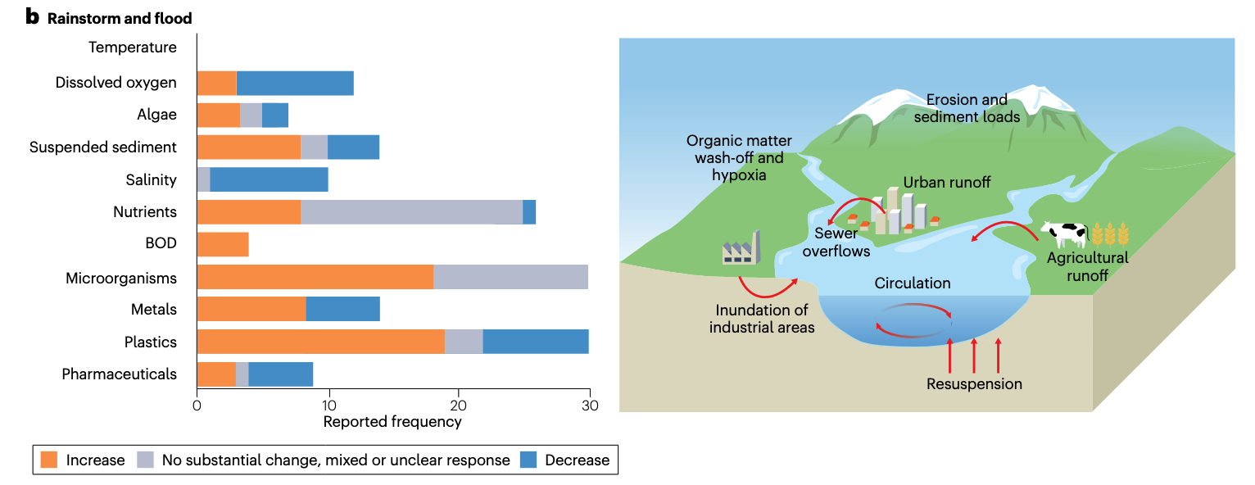
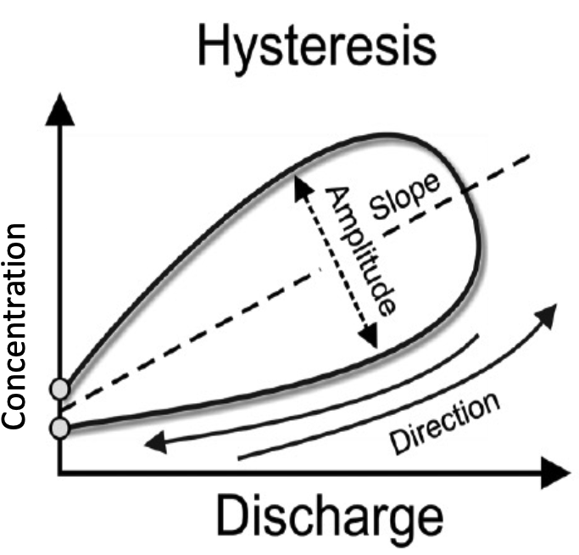
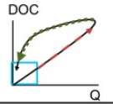
Rainstorms and floods
Metals, nutrients, plastics
Organic pollutants and pharmaceuticals
Depend on the types of solutes, their connection between sources and distinction to stream
Anticlockwise terrestrial DOC

Slide 8
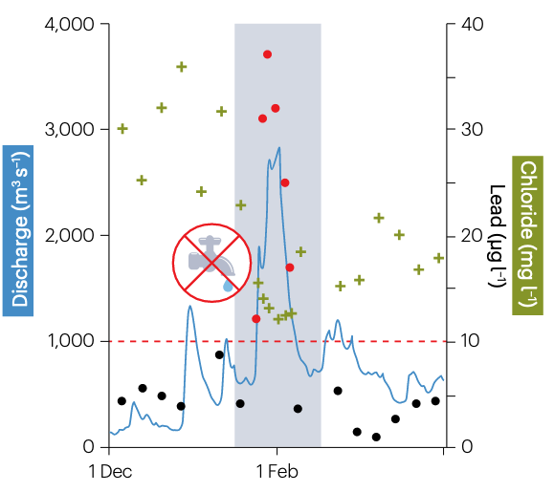

Rainstorms and floods
Overall deterioration to water quality (51%)
Droughts + Floods
Soil accumulates organic matter during drought,
Increasing microorganism during floods,
Safe drinking water threshold
Rapid degradation of organic matter
→ Hypoxia, high nutrient concentrations in water
Lead concentrations (red dots) during the 1995 flood event in the Meuse, western Europe. Corresponding decrease in chloride concentrations (green crosses) due to dilution. Values in black indicate concentrations that are meeting water quality requirements.

Slide 9

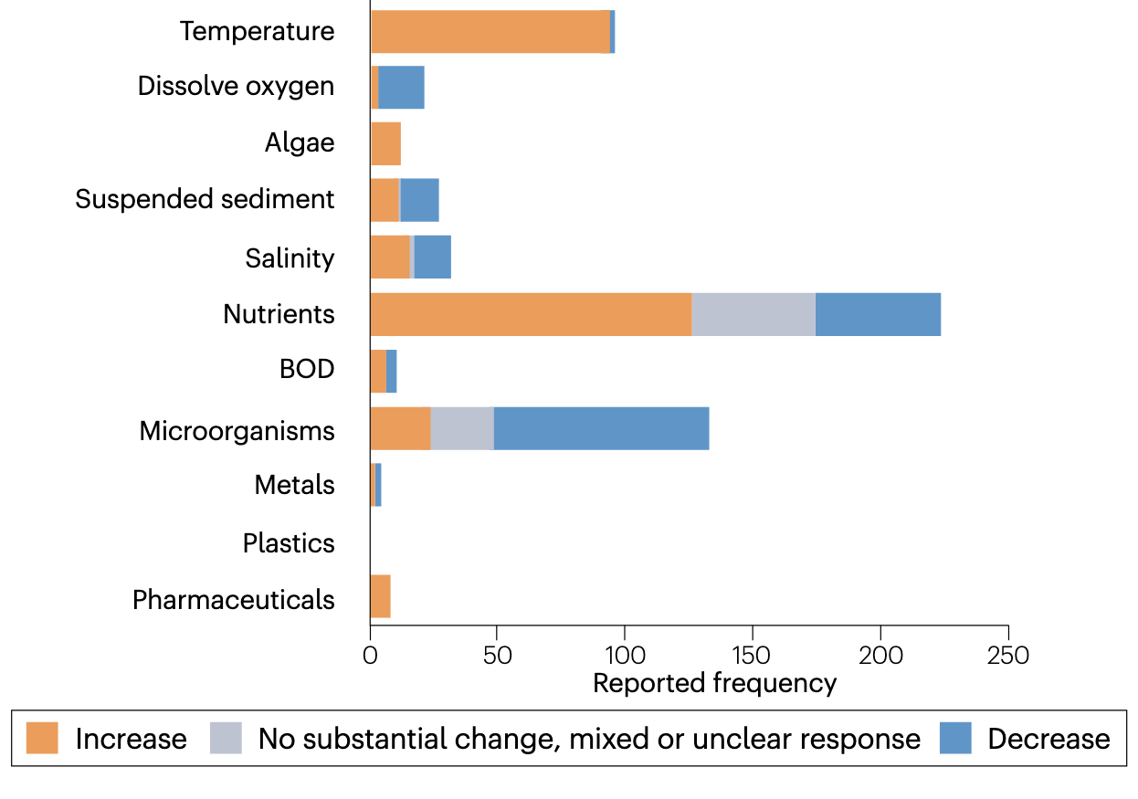
Long-term climate change
+
↑ 0.16 °C / 10 years mainly in Summer, streams in lowland catchments are more susceptible to hypoxia
Eutrophication
Turbidity and permeability
Pulses and dilution, Leaching from soil + anthropogenic inputs
Biochemical Oxygen Demand (organic pollution)

Slide 10
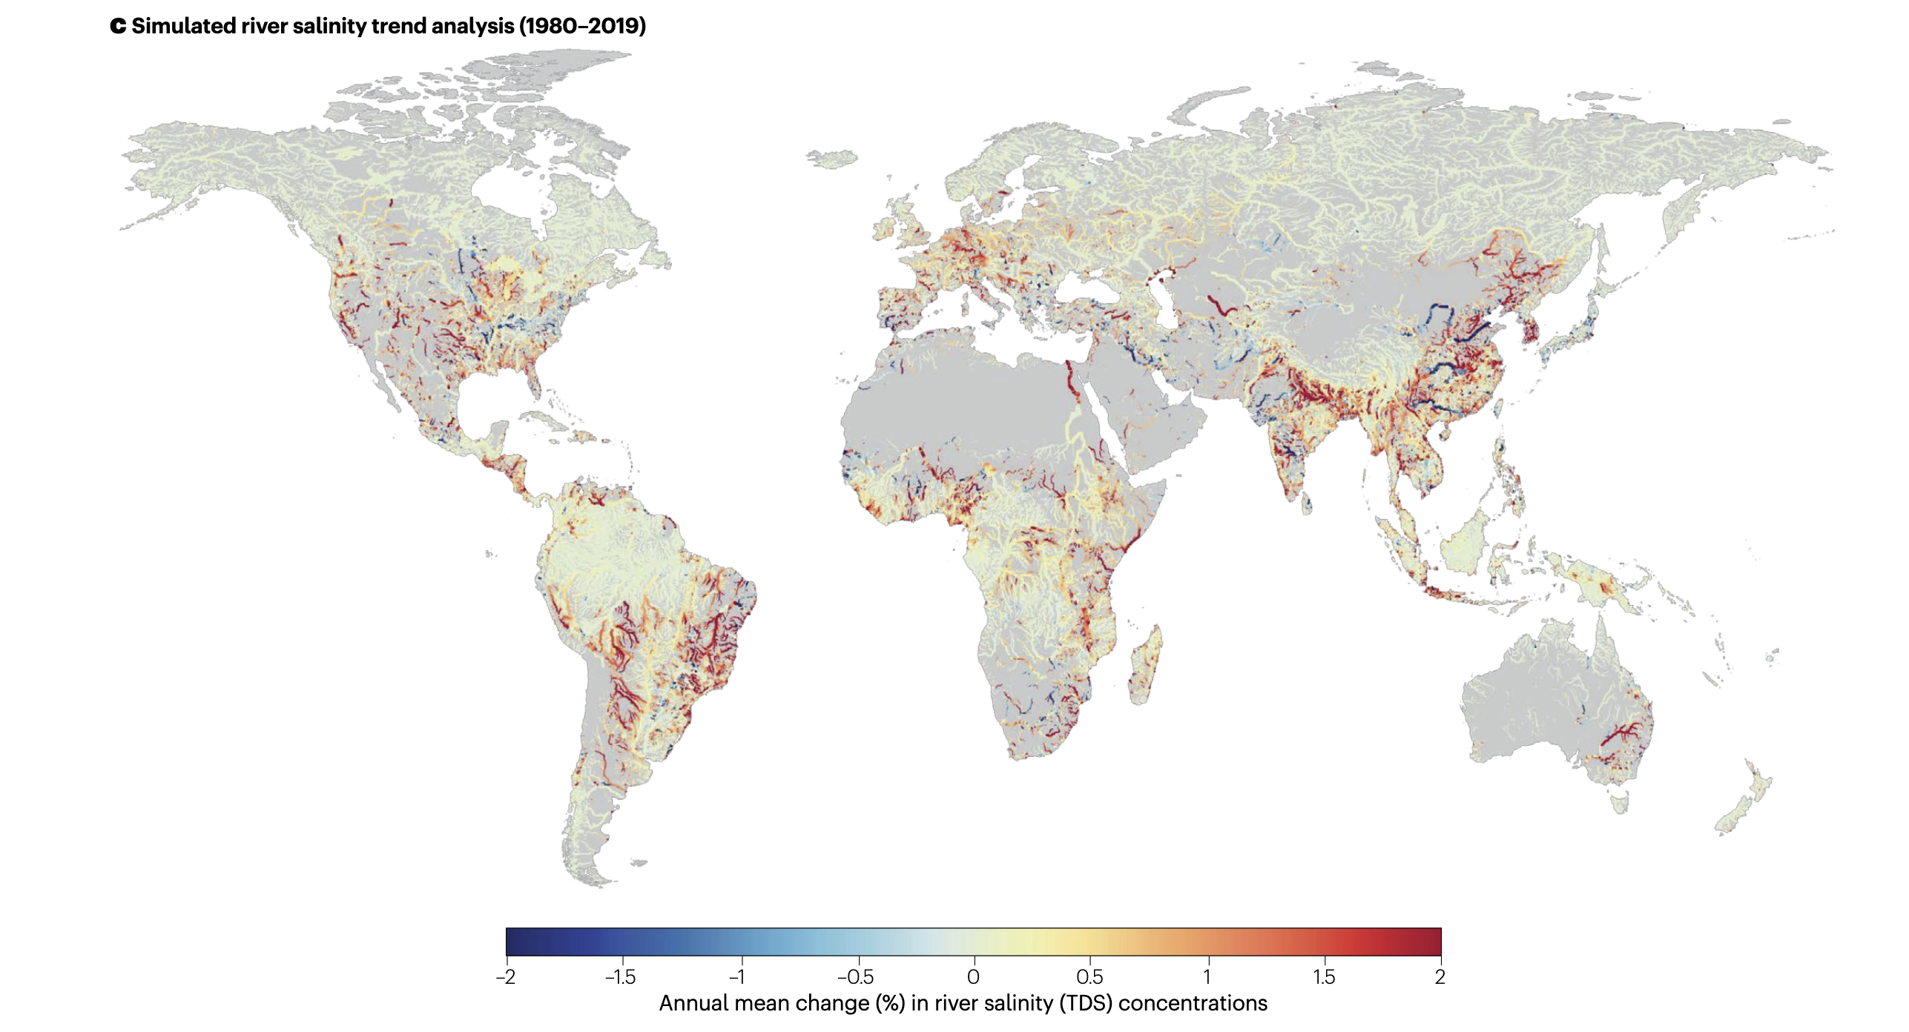
Land use and climate variability amplify unclearness of constituents
River network, multiple environmental conditions
Large variability: hydroclimatic +land use + other human-induced drivers
Jones et al., 2023
Expansions in manufacturing, irrigation activities, increased evaporation, seawater intrusion…
Dilution

Slide 11
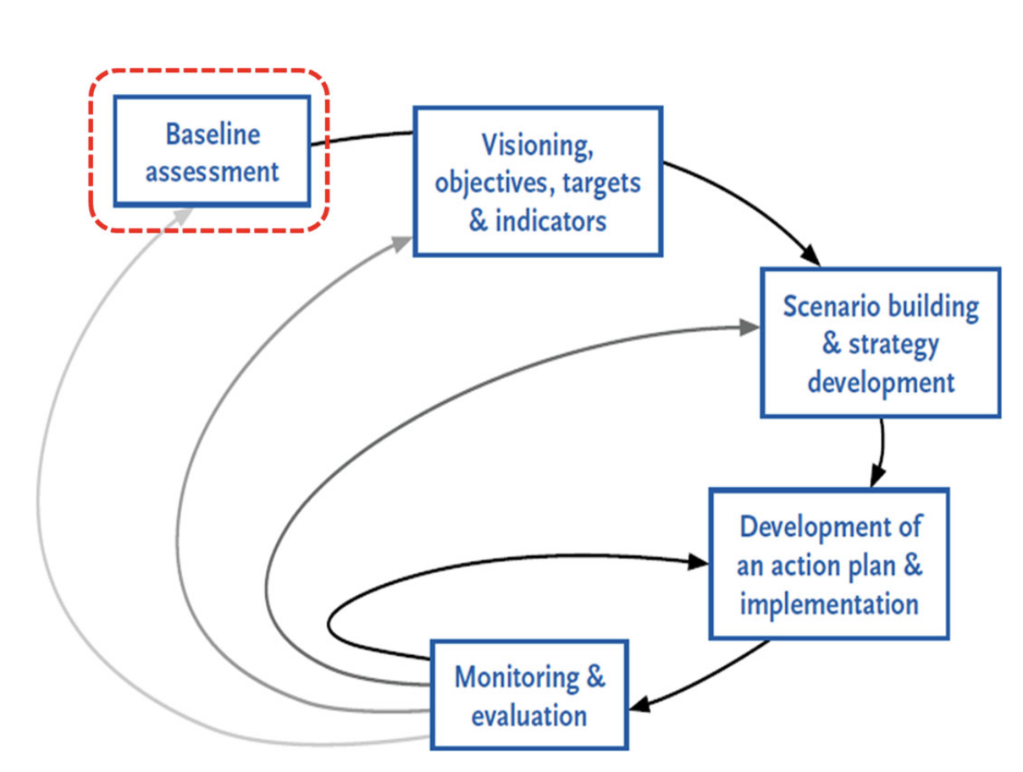
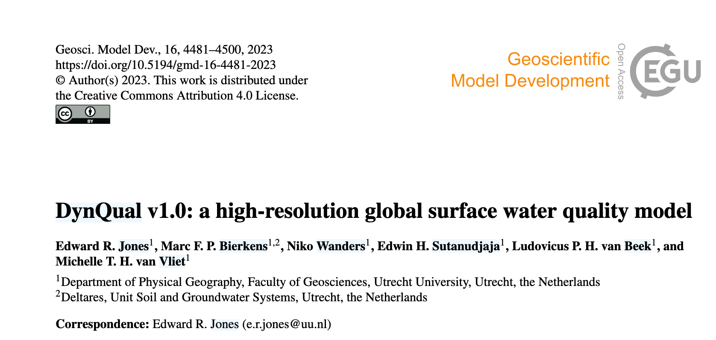
Sustainable integrated water resources management
By scientists
Governments and publics
Harmonized and up-to-date data at city level: urban hydro-informatics
(Koop and van Leeuwen et al., 2017)
The City Blueprint is both a process and tool (Philip et al. 2012)

Slide 12
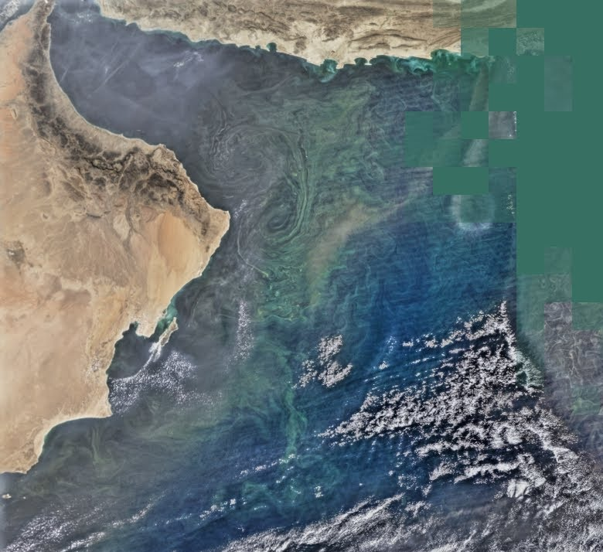
Remote sensing
Applications:
Identifying impacts of climate change and land-use patterns.
Mapping pollution hotspots and ecosystem vulnerabilities.
Challenges:
Limited to specific components.
Requires local calibration data for accuracy.
Duration can be over multi-decadal periods.
Tracks parameter inxludes chlorophyll a, turbidity, suspended sediment, water temperature, and nutrients.
Capacities:
Goals:
Utilizing satellite-based data to monitor global water quality patterns.
12
NASA, 2018,ARSET - Processing Satellite Imagery for Monitoring Water Quality

Slide 13

Internet of things, and Citizen science
IoT (Internet of Things):
High-frequency and real-time monitoring through intelligent sensors.
Captures short-term changes such as hydro-climatic events.
Citizen science:
Community-driven data collection using tools such as smartphone apps.
Example: Nitrate monitoring apps are available in the US, the Netherlands, and Denmark.
Benefits:
Democratising water monitoring.
Improving data availability in under-monitored regions.
Challenges:
High cost of sensors and maintenance.
Ensuring data quality and standardisation.

Slide 14
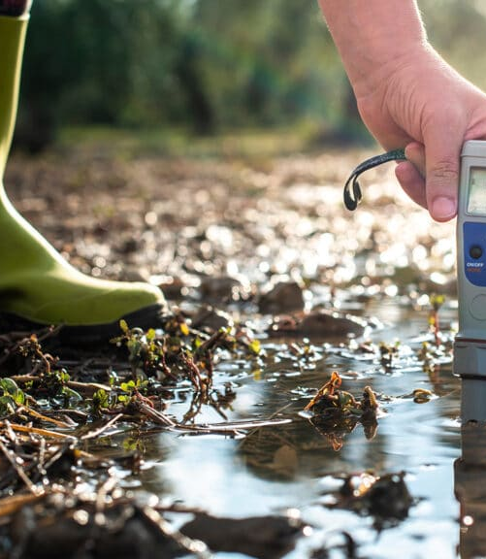
Process-Based Water Quality Models
Goals:
Using the models to simulate physical, chemical and biological processes affecting water quality.
Applications:
Identification of pollution hotspots and their sources.
Testing scenarios for climate and land use change.
Advances:
High-resolution simulations on daily or even hourly scales.
Integration with IoT for real-time validation.
Challenges:
Computationally intensive.
Requires high-quality input data for accuracy.

Slide 15
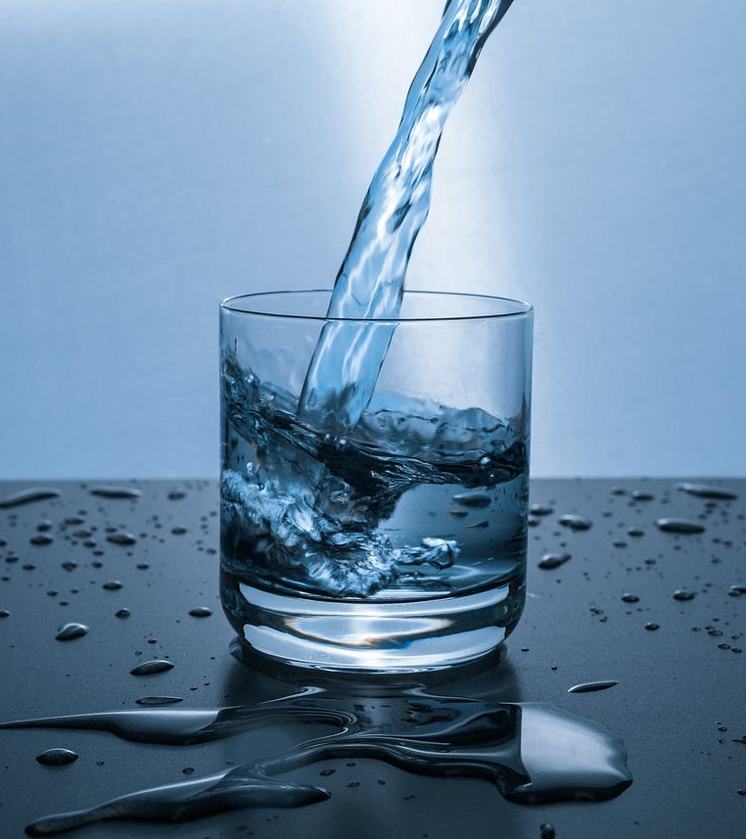
Data-Driven Models and Machine Learning
Goals:
Predicting and analyzing water quality trends using machine learning.
Techniques:
Neural networks, Random Forests, Support Vector Machines, and Fuzzy Inference Systems.
Strengths:
High spatiotemporal resolution.
Excellent for capturing non-linear relationships.
Rapid integration of diverse datasets (e.g., IoT, remote sensing).
Limitations:
Requires extensive training data.
Lacks interpretability compared to mechanistic models.
15

Slide 16

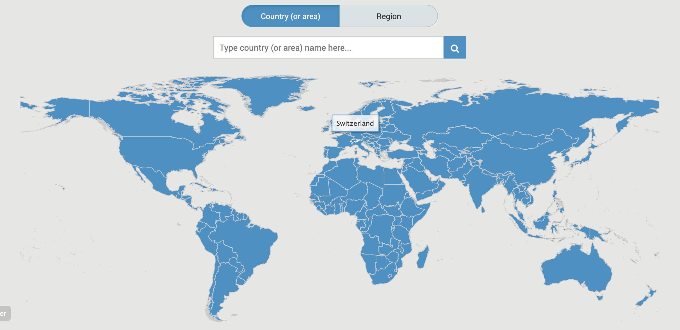







OUTLOOK…
Thank you!
Sustainable Development Goal 6 on water and sanitation (SDG 6), https://www.sdg6data.org/en

